Slide 1
INB/N 222 Enterprise Architecture Lectures 7 and 8 Modelling Business Objects in UML

Slide 2
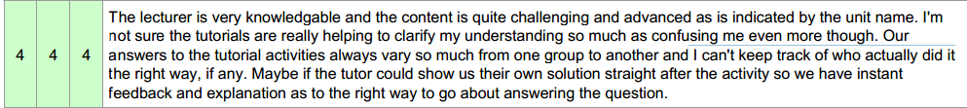
Reflect on the Pulse Survey
Things to keep
The balance between theoretical and practical aspects of the course
The interactive learning approach
Continuous Assistance
Detailed knowledge required through assignment tasks, general knowledge required through exam (see sample exam questions)
Things to improve
Present solutions at the end of the exercise clearly and clarify various solutions

Slide 3
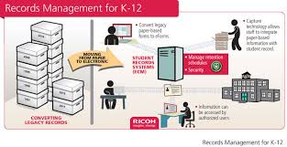

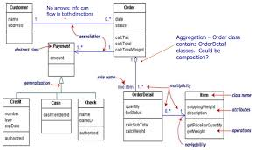
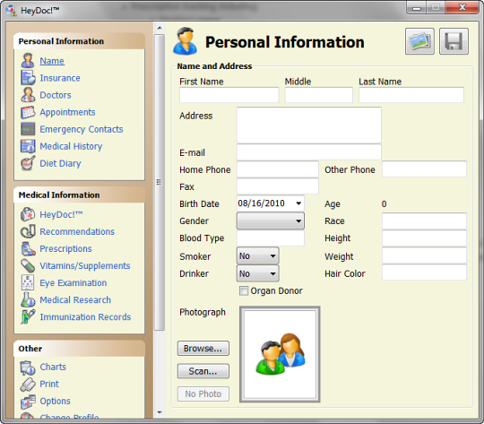
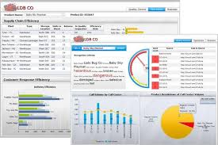
Notes:
Focus on information:
structure of information
help use to understand and clarify the requirements better
do this through models, showing detailed structure of information

Slide 4

Agenda
Background of business object modelling
How to structure a business object
How to relate business objects to each other
How to generalise business objects of similar types
Notes:
Not only we should have a complete picture of one or multiple business objects, but also the relationships between them.
Student -> the units they are enrolled in -> teaching team
A collection of these business objects and we need to relate them together
create an abstract business objects that represent different types, classes. For instance, teaching staff members: tutors, professors, and lectures

Slide 5
What is a business object?
A business object is an information record that in associated with an object of interest
It is managed by businesses and IT applications used to support businesses
It corresponds to data stored in:
Files, databases, documents and in other form of information exchange (e.g. email, fax, electronic data exchange/EDI documents)
Notes:
Example of business objects: books, cars, purchase orders
Break things down to units of interest

Slide 6
What is a business object?
Familiar examples:
Student (with student identifier, student name, etc)
Unit (unit code, unit name)
unit offering (unit offered in semester I/II of a year)
Lecture (lecture sequence identifier, duration, topic. location)
Lecturer (Staff identifier, staff name)
Workshop (workshop sequence number, duration, topic, location)
Tutor (Staff identifier, staff name)

Slide 7
What is a business object?
Common examples in IT enterprise applications:
Customer
Employee
Project
Product/service
Purchase order
Line item (of purchase order)
Material
Order contract

Slide 8
What is a business object?
Business objects can correspond to concrete (tangible) or virtual (intangible) things
What are examples of both?
Business objects can correspond to real-world or IT only things
Examples?
Data modelling provides a conceptual (implementation free) understanding of the structure and relationships of business objects

Slide 9
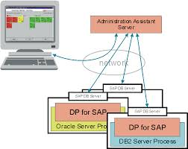
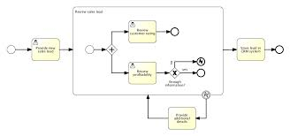
Recap: EA to Solutions
Enterprise Architecture
Solution Architectures
BUSINESS PLANNING:
Capability Map
EA Business-to-IT Models:
Archimate
SOLUTION PLANNING
Detailed
data
analysis
Software
Design/
configuration
High-level
Process
map
Data models
Integrated
scenarios
Technical
analysis
BUSINESS PLANNING:
Value Streams
Detailed
process
analysis
Process models

Slide 10
Agenda
Background of business object modelling
How to structure a business object
How to relate business objects to each other
How to generalise business objects of similar types

Slide 11

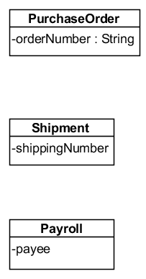



Abstracting objects
Objects are abstractions of real-world or system things
Reality Domain
Model Domain
Model
element
for object
and way it
is uniquely
identified

Slide 12
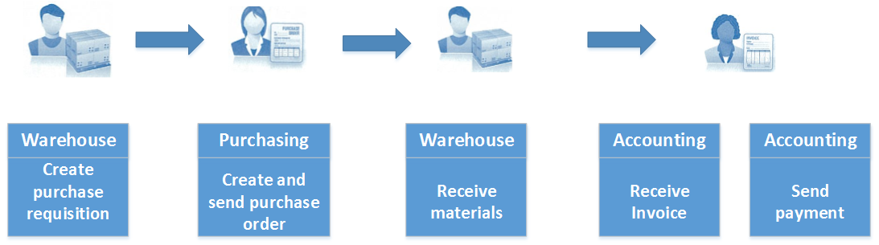
Key Business Objects in the SAP ERP Procurement Process
The procurement process includes all of the tasks involved in acquiring needed materials externally from a vendor. The process begins when the warehouse recognises the need to procure materials, perhaps due to low levels of inventory. The warehouse then documents this need in the form of a purchase requisition, which it sends to the purchasing department. In turn, the purchasing department identifies a suitable vendor, creates a purchase order, and sends it to the vendor. The vendor ships the materials, which are received in the warehouse. The vendor then sends an invoice, which is received by the accounting department. Accounting then sends payment to the vendor, thereby completing the process.

Slide 13
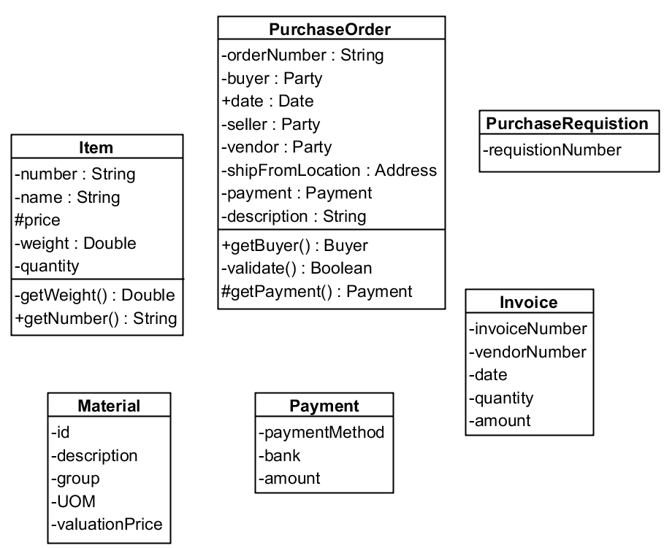
Key Business Objects in the SAP ERP Procurement Process
Purchase Requisition
Purchase Order
Item
Material
Invoice
Payment

Slide 14
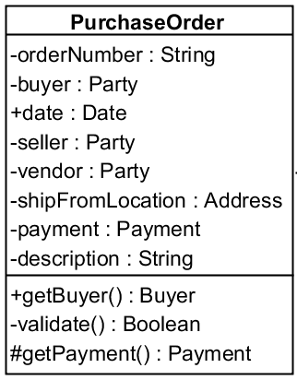
UML Classes: Representing Business Objects
Class Name
A Class is a general type for
Objects.
At detailed design and
in programs, it represents a part of a program used as basis for defining and instantiating objects in-memory
Attributes
Operations

Slide 15

Attributes - Signature
Not all details are applicable in this unit
[visibility] name [[multiplicity]] [: type] [=initial value] [{property}]
visibility: the access rights to the attribute (“public, “private” or “protected”)
multiplicity: how many instances of the attribute are there:
middleName [0..1] : String, phoneNumber [1..*]
Type: the type of the attribute (integer, String, Enum, Person, Course)
initial value: a default value of the attribute
salary : Real = 10000, position : Point = (0,0)
property: predefined properties of the attribute
Changeable, readOnly, addOnly, frozen (C++: const, Java: final)

Slide 16
Attributes - Examples
Not all details are applicable in this unit
orderNumber : String {readOnly}
buyer : Party // complex data type
+ date : Date

Slide 17
Operations – Signature
Not applicable in this unit
[visibility] name [(parameter-list)] [: return-type] [{property}]
An operation can have zero or more parameters, each has the syntax:
[direction] name : type [=default-value]
Direction can be: in (input parameter - can’t be modified), out (output parameter - may be modified), input (both, may be modified)
Property:
{leaf} – concrete operation
{abstract} – cannot be called directly
{isQuery} – operation leaves the state of the operation unchanged
…

Slide 18
Operations - Examples
Not applicable in this unit
+ getBuyer() : Party
# getPayment() : Payment
- validate(): Boolean

Slide 19
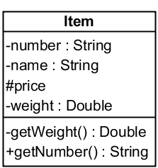
Visibility
Not applicable in this unit
public (+) – external objects can access the member
private (-) – only internal methods can access the member
protected (#) – only internal methods, or methods of specialized objects can access the member

Slide 20
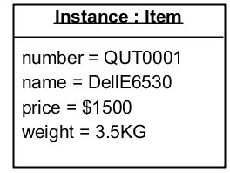
UML Object Diagram
Not applicable in this unit
In a UML Object Diagram, class instances can be modelled
In runtime
Class Diagram
Object (instance) Diagram

Slide 21
Agenda
Background of business object modelling
How to structure a business object
How to relate business objects to each other
How to generalise business objects of similar types

Slide 22
Relationships
Business objects have information related:
Attributes stored as part of a business object
Other business objects
Examples of how business objects relate to each other:
A student is enrolled in a unit in a given year/semester
A unit has a unit coordinator, lecturers and tutors
A purchase order has line items
A line item has a material and a quantity

Slide 23
Relationships
Capturing relationships between business objects provides a more complete picture of the information of interest
The modelling challenge is capture the relationships at the right level, to capture distinct requirements:
A unit is offered in a unit offering (year/semester)
A student is currently enrolled in a unit offering
A student has previously taken a unit offering
A student is enrolling in a unit offering

Slide 24
UML Relationships
Association: a relationship between classes, allowing one object instance to cause another to perform an action on its behalf
Composition: a kind of association where the composite object has sole responsibility for the disposition of the component objects, i.e. it strictly contains the objects. When the composite object is destroyed, so are the component objects
Aggregation: A kind of association that involves weak containment. When the owning object is destroyed, the contained objects are not necessarily removed.
Dependency: a weaker form of bond which indicates that one class depends on another because it uses it at some point in time. For example, Car uses Wheel. This form of relationship is for technical analysis only.

Slide 25
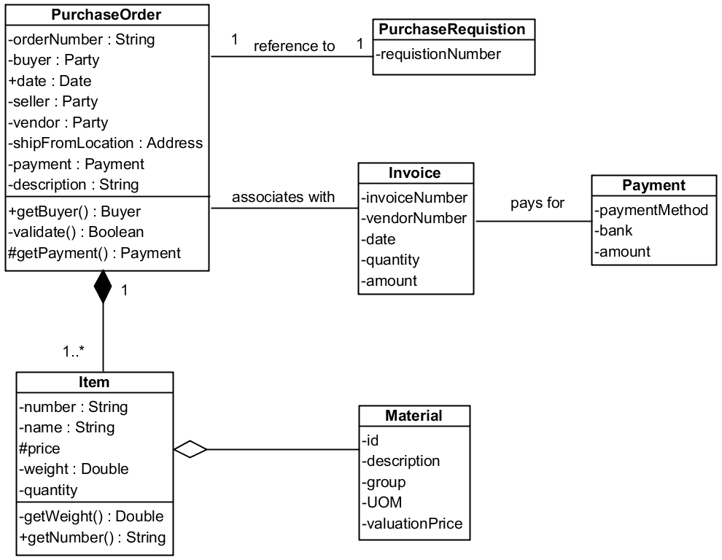
Key Business Objects and their relationships in the SAP ERP Procurement Process
Purchase Requisition
Purchase Order
Item
Material
Invoice
Payment

Slide 26
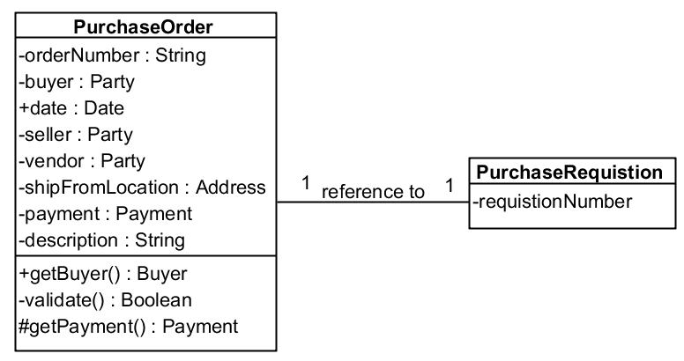
Associations
Multiplicity
Indicates cardinality
1:1 – default
3 – exactly 3 object
*(or n) – unbounded
1...* - 1 to eternity
3...9 – 3 to 9
Name and reading direction
Objects on both sides of the association can find each other

Slide 27

Navigation
Why is it directional? For example, we want to the items contained in a purchase order. However, we do not have a requirement for knowing purchase order of each item.
If an association is directed, messages can pass only on that direction
If the association does not have directions, then it’s defined as a bidirectional association, and messages can pass in both directions
By default, all relations should be directed, unless the requirements dictate a bidirectional relation

Slide 28
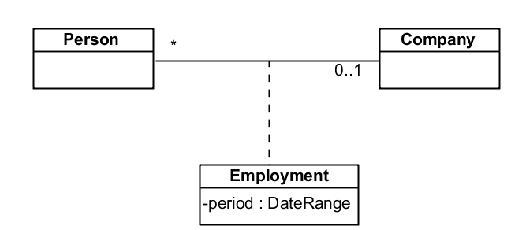
Association Classes
Denoted as a class attached to the association, and specify properties of the association
An association class is a “normal” class, and may include relations, inheritance etc.

Slide 29
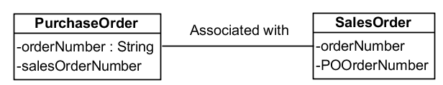
Relations & Attributes
What is the problem here?
Relations are denoted with associations, not attributes.
Implementation (pointers, arrays, vectors, ids etc) is left to the detailed design phase.

Slide 30
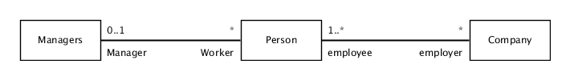
Role Names
Names may be added at each end of the association
Provide better understanding of the association meaning
Especially helpful in self-associated classes

Slide 31
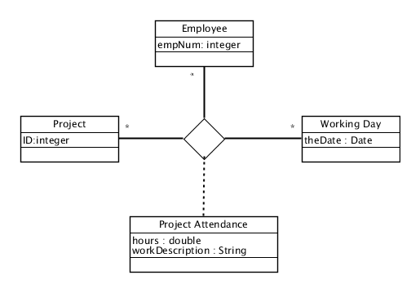
Ternary Associations

Slide 32
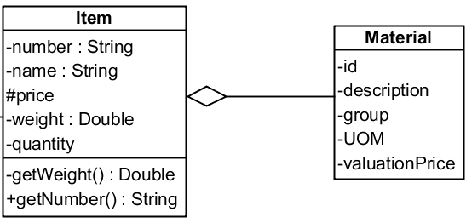
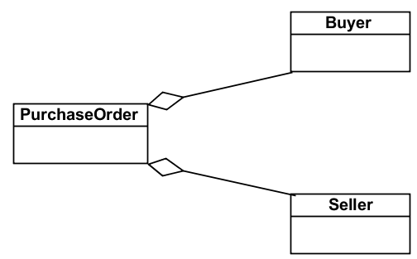
Aggregation
“Whole-part” relationship between classes
Assemble a class from other classes
Combined with “many” - assemble a class from a couple of instances of that class

Slide 33
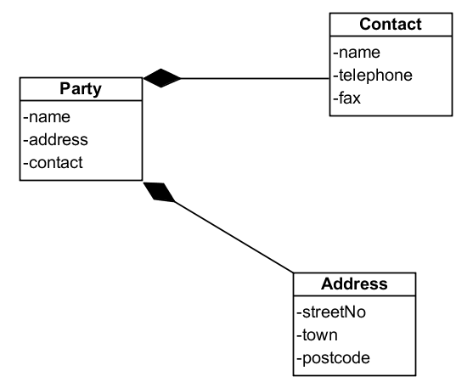
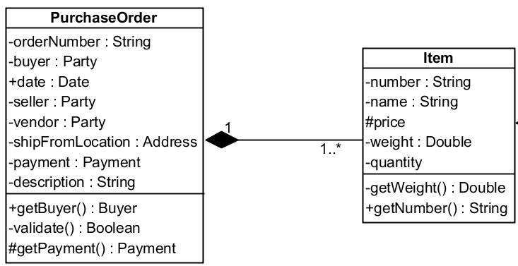
Composition
Composition is a stronger form of aggregation
Contained objects that live and die with the container
Container creates and destroys the contained objects

Slide 34
Composition vs. Aggregation
Aggregation | Composition
Part can be shared by several wholes | Part is always a part of a single whole
Parts can live independently (i.e., whole cardinality can be 0..*) | Parts exist only as part of the whole. When the wall is destroyed, they are destroyed
Whole is not solely responsible for the object | Whole is responsible and should create/destroy the objects

Slide 35
Agenda
Background of business object modelling
How to structure a business object
How to relate business objects to each other
How to generalise business objects of similar types

Slide 36
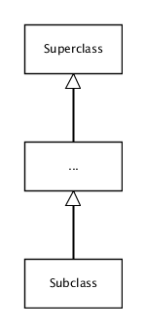
UML Generalisation
Super Class (Base class)
Provides common functionality and data members
Subclass (Derived class)
Inherits public and protected members from the super class
Can extend or change behaviour of super class by overriding methods
Overriding
Subclass may override the behaviour of its super class (technical analysis only)
Notes:
Note: remove the overriding bullet

Slide 37
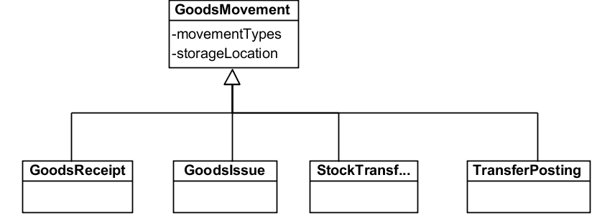
Generalisation – advantages
Eliminate repeating details
Find common characteristics among classes
Capture natural and useful hierarchies
Allow objects to be further specialised for different applications

Slide 38
Agenda
Background of business object modelling
How to structure a business object
How to relate business objects to each other
How to generalise business objects of similar types

Slide 39
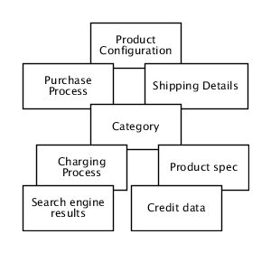
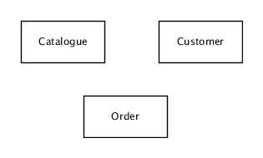
Guidelines
Bottom-up Process
Top-down Process
Starting with throwing all classes on the page, and then combining them:
Starting with an overview of the system, and then splitting
classes

Slide 40
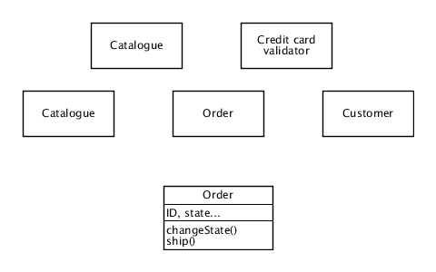
Top-Down Methodology
Analyzing Scope
Identifying major classes
Identifying properties
Identifying methods
Order
id
State
started, ended
Refining and normalizing classes
Order
id
Business Order
Generalizing classes
: Order
id = 18734
: Customer
name = “cohen”
Reviewing

Slide 41
The Data Modelling Approach – Noun Extraction
Step 1. Identify the Nouns
Step 2. Remove the nouns that lie outside of the problem boundary
Step 3. Draw the nouns determined as classes and attributes and place them properly on a class diagram
Step 4. Figure out relationships between classes
Step 5. Refine the model

Slide 42
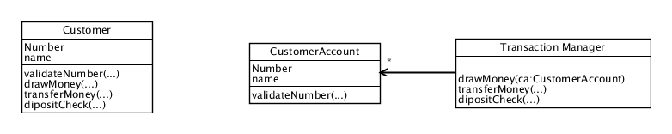
Guidelines – Modelling Actors
A common mistake is to model actors as classes:
Actors interact with the system directly, they don’t need to be represented a priori
Sometimes, the system saves data about customers, but it does not mean that they do all their actions through this class

Slide 43

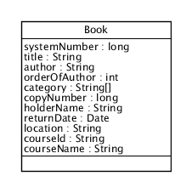
Designing Business Objects in Databases
Not applicable in this unit
A naïve model may have a bad problem of coupling:
Data is inter-related
It is difficult to manage data items individually
Normalization:
A collection of design strategies
Ensures loosely coupled design
Origin: relational database
But, we do not have primary keys in Class diagram
Naïve Model
Notes:
Problems:
1. The number of categories is unlimited. This is a problem, as we want to control each category individually. Also, imagine what would happen if we would have a category ID?

Slide 44
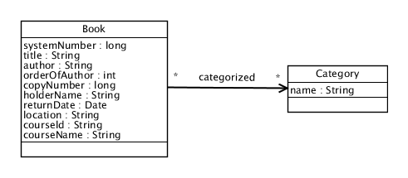
First Normal Form
Not applicable in this unit
All properties must have a final number of values
The number of
categories for a
book is unbounded
Notes:
Also add example of n:n

Slide 45
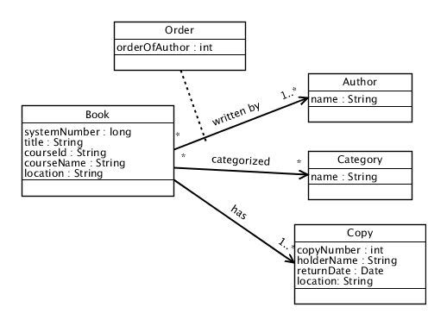
Second Normal Form
Not applicable in this unit
All properties must depend on the whole class essence, and not just a part of it

Slide 46
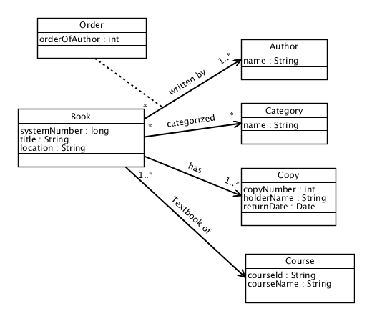
Third Normal Form
Not applicable in this unit
All properties must depend only on the class’s essence

Slide 47
Key concepts recap
Business objects and basic guidelines for BO modelling
How business objects relate to modelling in EA and solution architecture
Business objects structure in UML:
UML Classes, attributes & operations
Classes vs object instances
Business object relationships in UML:
Associations: binary, ternary, n-ary, association classes
Cardinality constraints on associations
Compositions (strict containment)
Aggregations (weak containment)
Business object specialisations:
Super-class, sub-class, generalisation, specialisation

Slide 48
Sample exam questions
In the modeling of business objects (data) using UML Class Diagrams, which of the following distinguishes a class from an attribute?
A class represents the type of a particular data object being modeled while an attribute is a descriptive part of it
Classes and attributes are different ways of referring to the same concept, namely a data object
Classes represents the type of a particular data object being modeled while an attribute is used for the relationship that a class plays
The distinction of a class representing the type of a particular data object and an attribute being a descriptive part of it is only relevant when doing programming
None of the above.
In the modeling of business objects (data) using UML Class Diagrams, which of the following distinguishes a class from an object instance?
Classes model information types (definitions) while instances capture examples of these
Classes model examples types while instances capture information types (definitions)
Classes model information types (definitions) while instances capture attribute values using in classes
Classes model information types (definitions) while instances capture relationships between classes
None of the above

Slide 49
Sample exam questions
In the modeling of business objects (data) using UML Class Diagrams, classes can be identified in requirements through?
Nouns (e.g. things)
Verbs (e.g. actions)
Adjectives (e.g. qualifications of things, like size)
All of the above
None of the above
A purchase order has at least one line item. For a relationship between a purchase order class and line item class (in that direction), what would reflect the cardinality constraint, in UML Class Diagrams, to capture this requirement (noting that “n” and “m” represent any positive numbers above 0)?
0 .. n
0 .. 1
1 .. n
n .. m
n (exactly a fixed number denoted by n)

Slide 50
Sample exam questions
Which of the following should be modeled through a composition (containment) association, in UML Class Diagrams?
A purchase order has an ordering department
A purchase order has line items
A purchase order is shipped through a carrier
A purchase order is allocated to containers on a carrier
None of the above
What does a specialization of a class (or sub-class) mean, in UML Class Diagrams?
A particular class which has all the characteristics (relationships, attributes and operations) of a parent class but with further characteristics
A particular class which has some the characteristics (relationships, attributes and operations) of the parent class and some other characteristics
A particular class which can have the characteristics (relationships, attributes and operations) of the parent class which can be replaced by other, similar characteristics (e.g. a generic postal address replaced by an Australian postal address)
A class which has an association with itself (e.g. an employee reports to an employee)
Both A and C

Slide 51
Sample exam questions
Which of the following best describes an association class in UML Class Diagrams?
It allows associations to be made against a combination of classes, otherwise there would be information loss
It provides an alternative way of saying one class is contained by another
It allows associations to highlighted for documentation purposes
All of the above
None of the above
Which of the following architectural settings is UML Class Diagrams used in?
Enterprise architecture only
Solution architecture only
Enterprise architecture for major business objects that apply across different parts of an enterprise, and solution architecture for detailed analysis of data
Enterprise architecture for major business objects that apply across different parts of an enterprise, and solution architecture for those major business objects only
None of the above

Slide 52

Questions, reflections, follow-ups

Slide 53

Prof. Alistair Barros
Smart Services CRC Chair for Services Science and Computing
School of Information Systems
Faculty of Science and Engineering
Queensland University of Technology
Email: alistair.barros@qut.edu.au
Skype: alistairbarros
Web: http://www.alistairbarros.com

